Slide 1
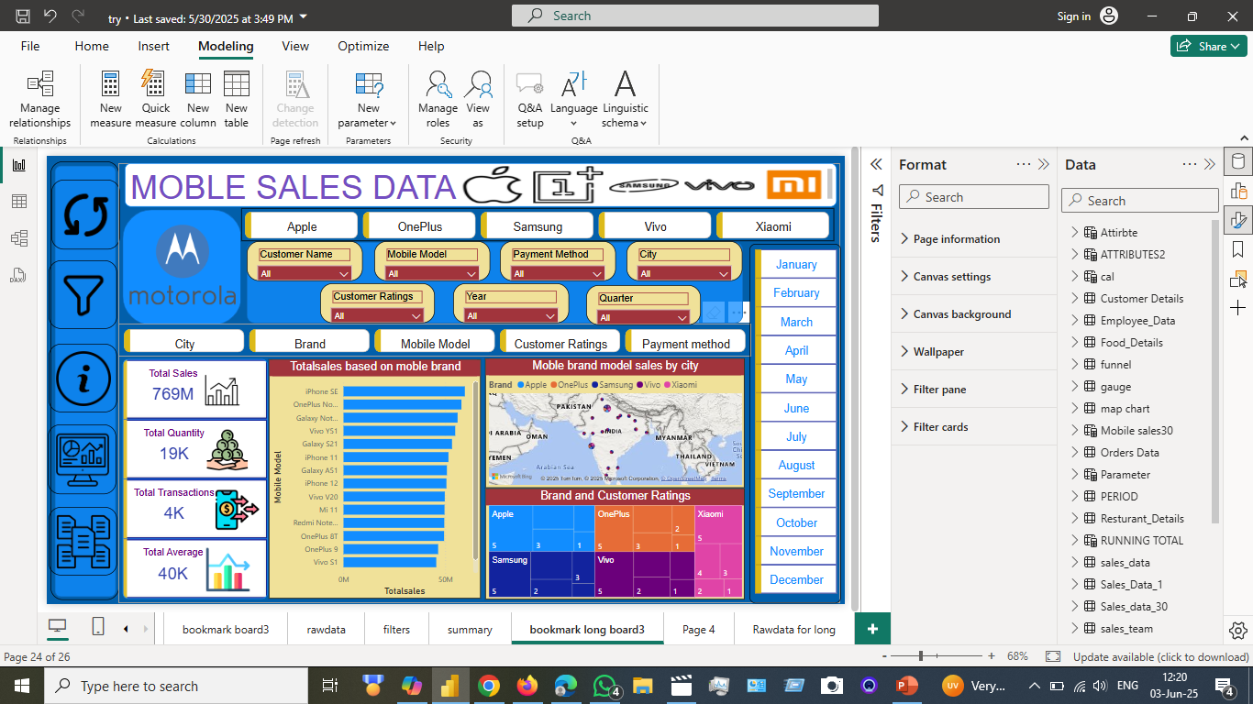
I create the dashboard to identify the sales and ratings of mobiles based on brands with bookmarks, buttons by using filters, shapes, slicers, assign borders and images and different visuals to identify business requirements and slicers

Slide 2
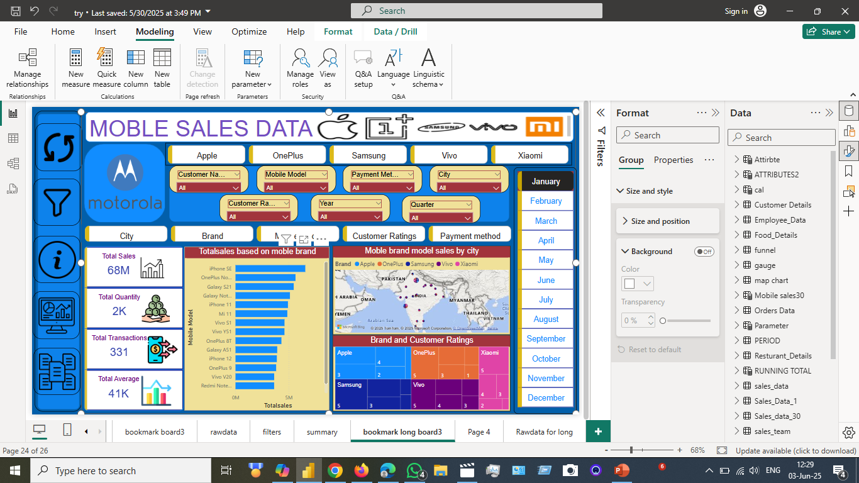
We check slicers to identify the month sales of brand wise mobile ratings and city to check saales and ratings of brand

Slide 3
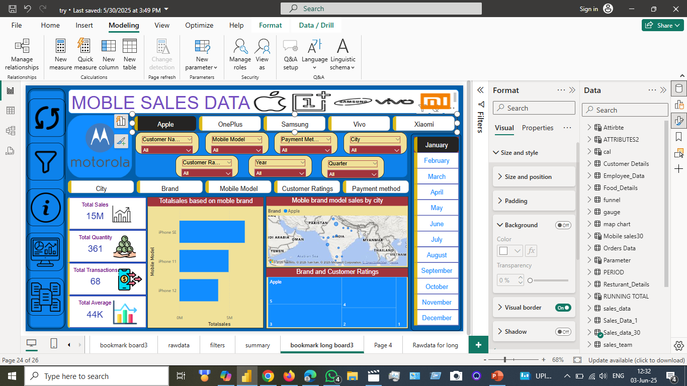
While click on the apple brand and identify the sales monthly and quantity of data transactions

Slide 4
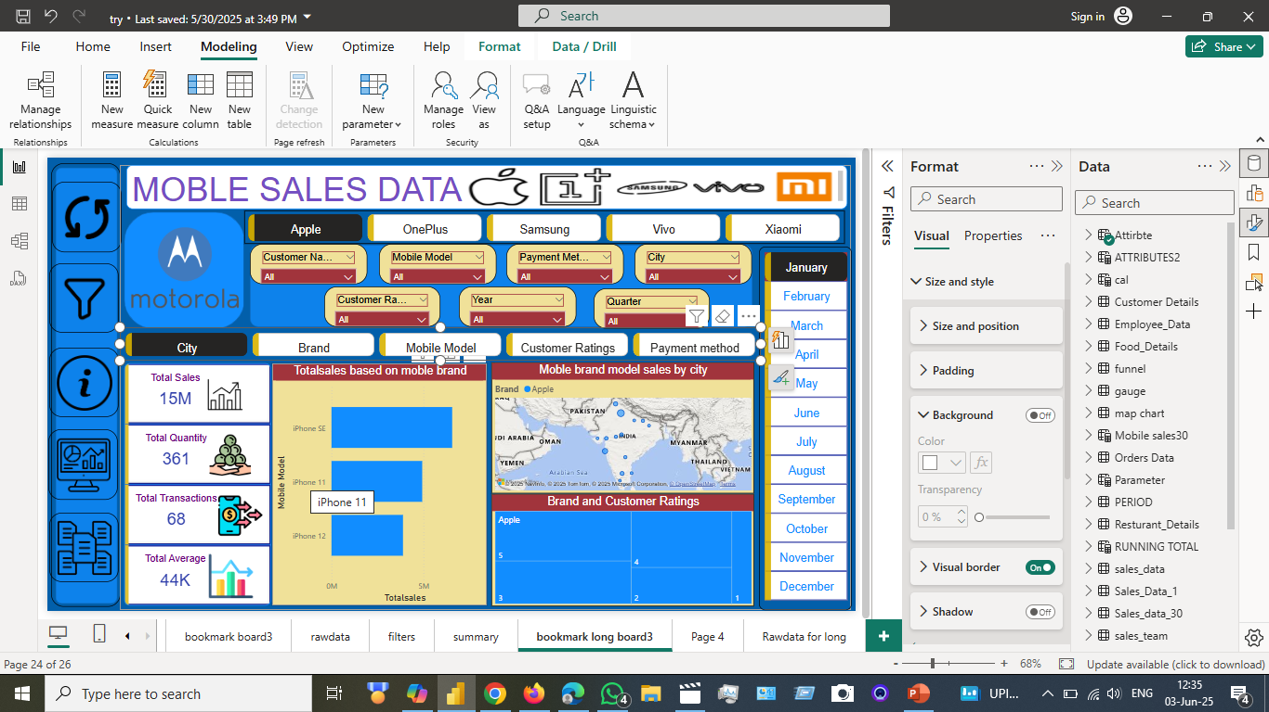
While click on brand city sales, quantity ratings based on city

Slide 5
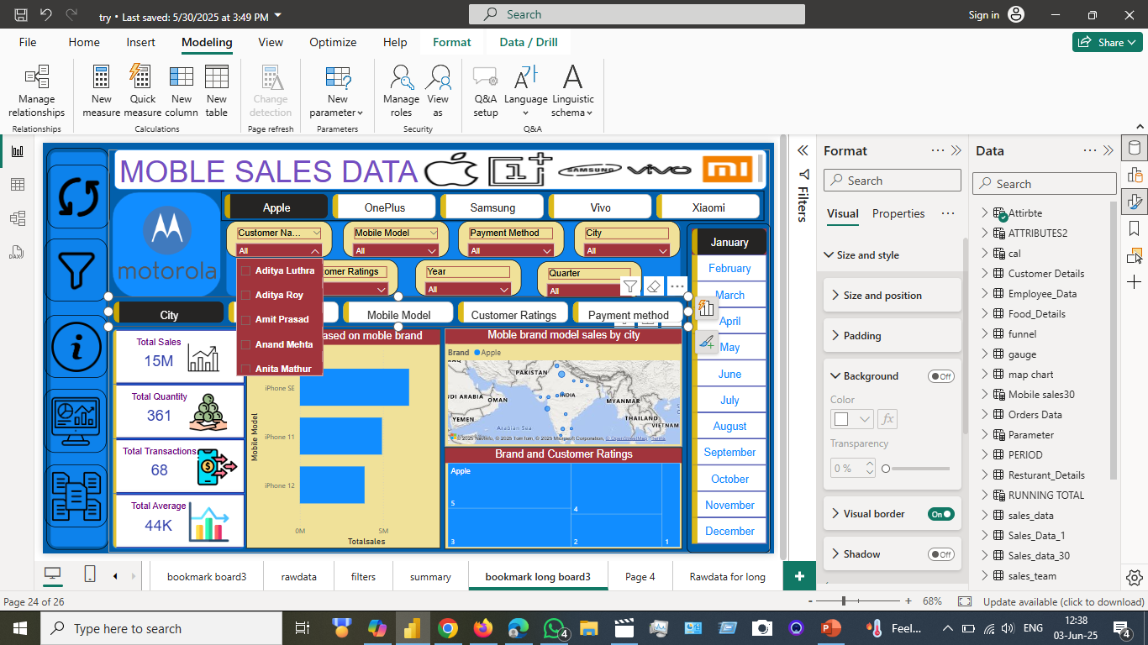
Client that checks the city-wise customers to identify the city and ratings of mobiles based on brands that are chosen by customers

Slide 6
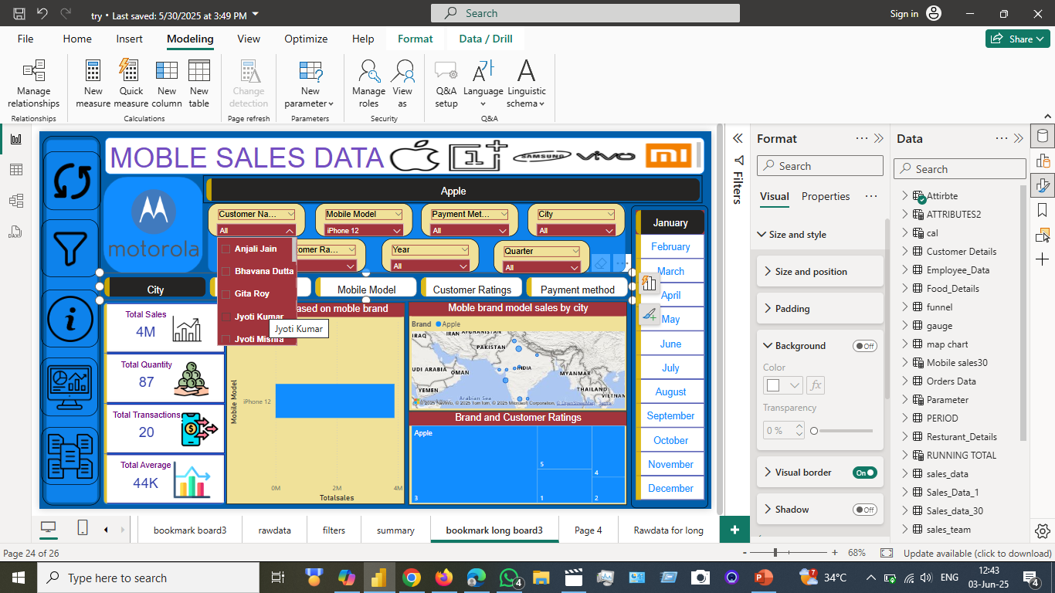

Check the sales that assign to the model and customer names and models

Slide 7
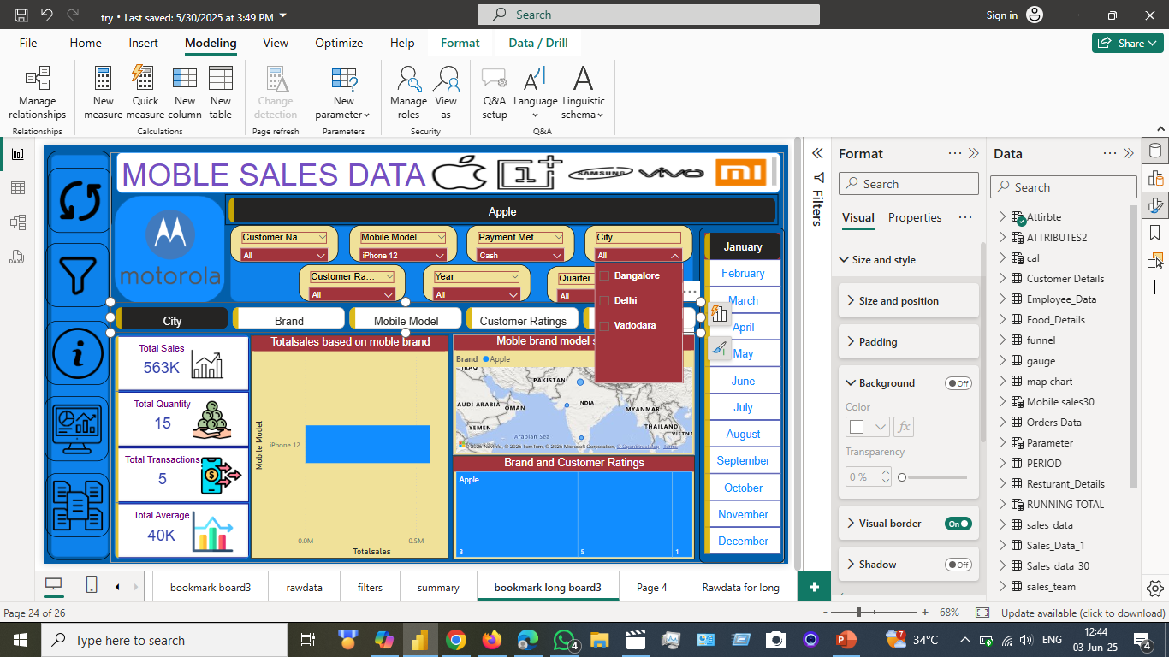


City wise models of mobile in apple brand to city

Slide 8
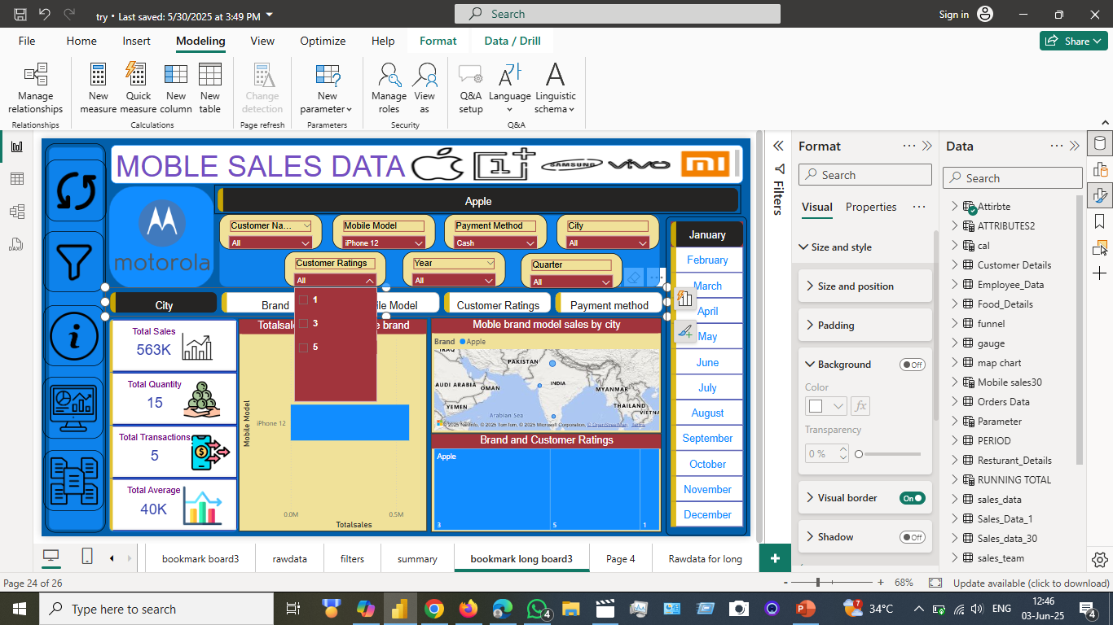
Check that the client that will buy the model of brand and ratings of model thar can show by customers

Slide 9
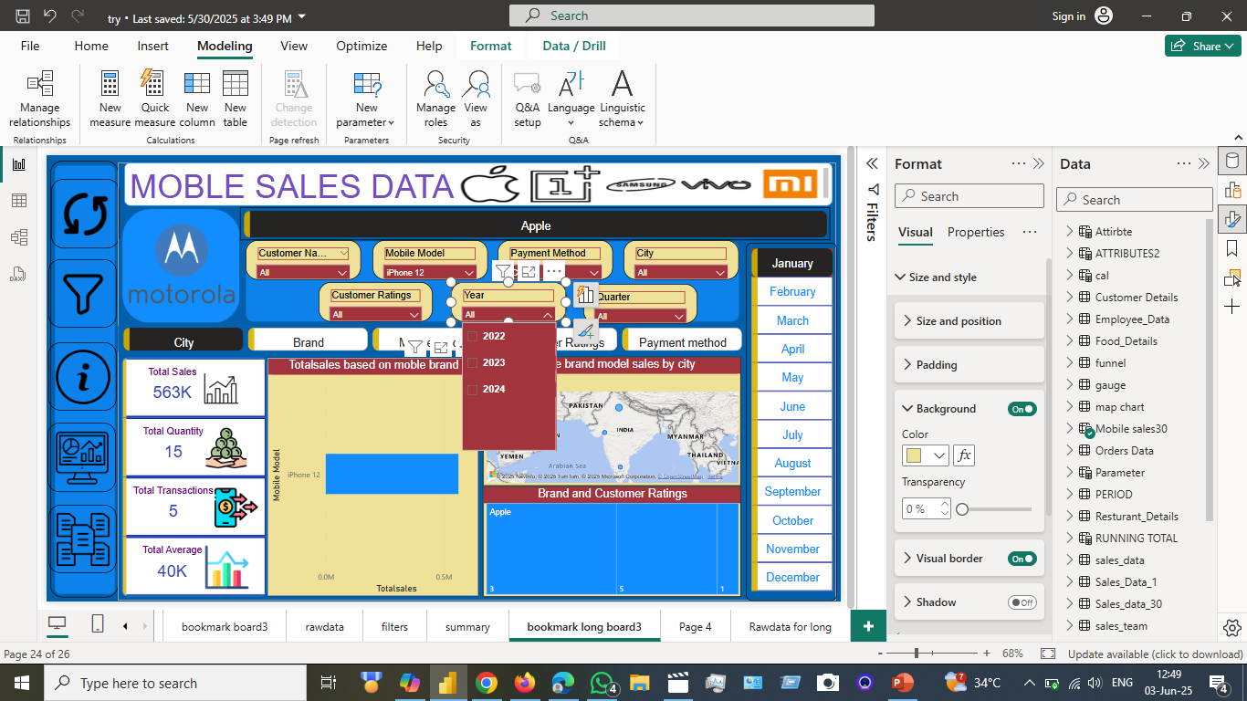
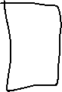
Check that the client that will buy the model of brand and ratings of model thar can show by customers based on year

Slide 10
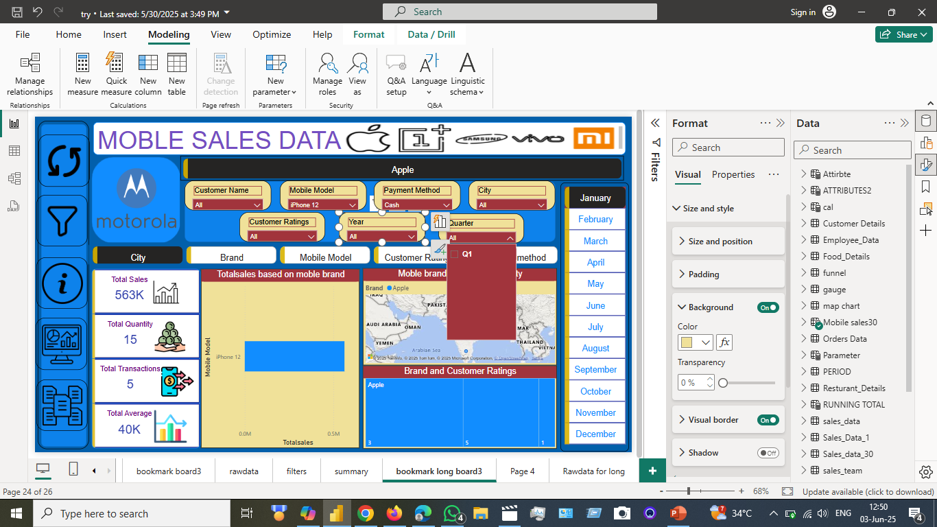
Check that the client that will buy the model of brand and ratings of model thar can show by customers based on quarter

Slide 11
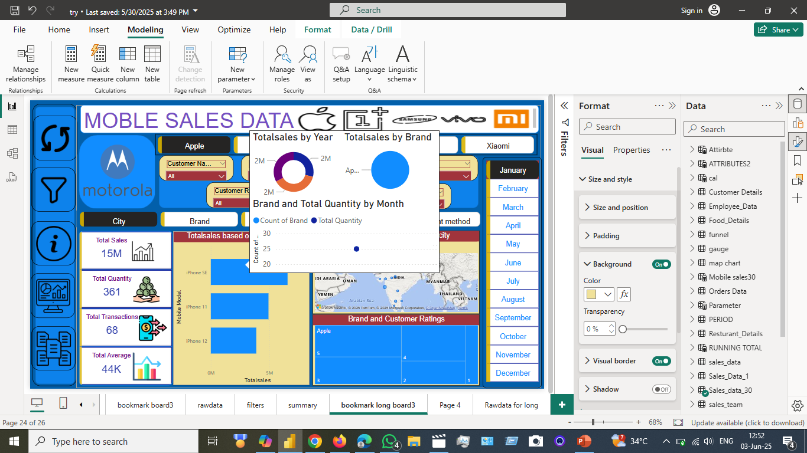
Check that the client who will buy the model of the brand and ratings of the model that can be shown by customers based on all models of the particular brand

Slide 12
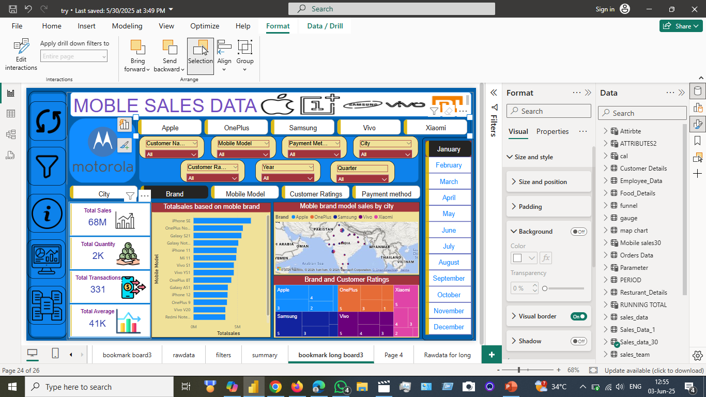

Check that the client who will buy the model of the brand and ratings of the model that can be shown by customers based on all models of brand

Slide 13
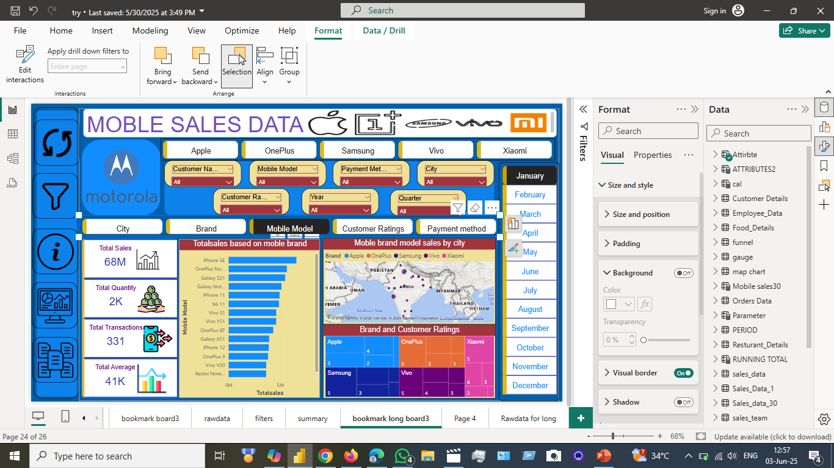

Check that the client who will buy the model of the brand and ratings of the model that can be shown by customers based on mobile models’ overall sales, quantity, average sales, transactions

Slide 14
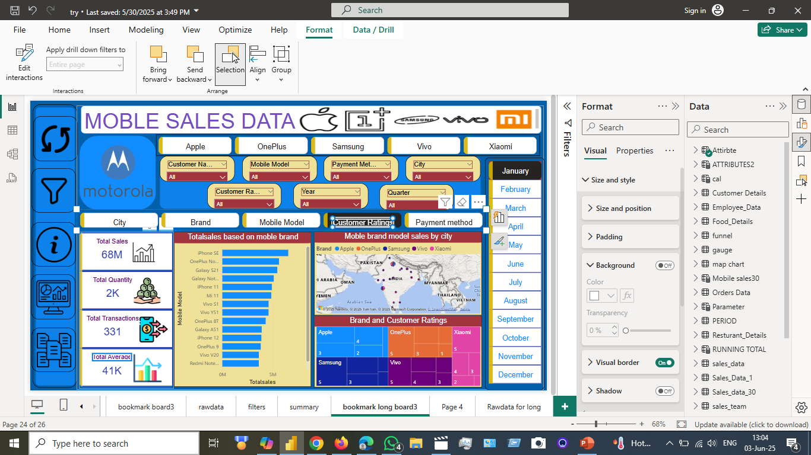
Check that the client who will buy the model of the brand and ratings of the model that can be shown by customers based on the mobile models’ overall sales, quantity, average sales, transactions, customer ratings in a particular month and brand mobiles and models

Slide 15
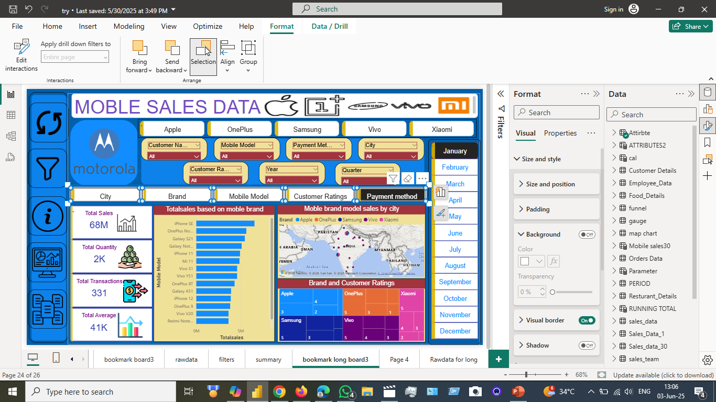
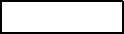
Check that the client who will buy the model of the brand and ratings of the model that can be shown by customers based on the mobile models’ overall sales, quantity, average sales, transactions, customer ratings in a particular month sales brand models and payment methods

Slide 16

We can assign models to buttons by using bookmarks and actions to particular fields and title to particular buttons

Slide 17
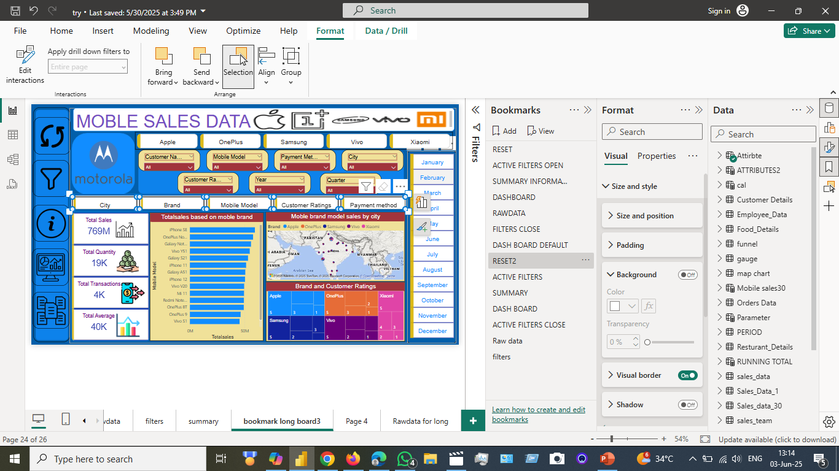

When we assign the data to particular buttons, we can create bookmarks and assign to dashboard by using selection pans

Slide 18
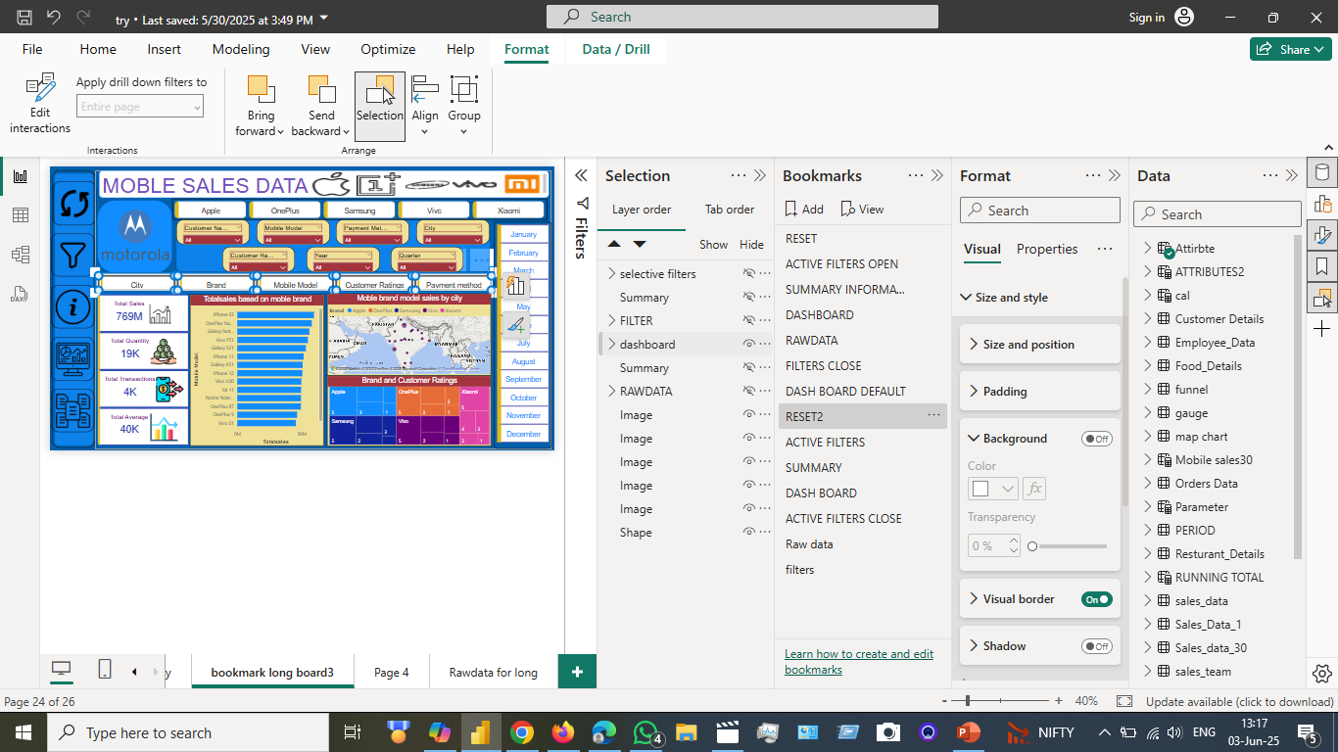


When we assign the data to particular buttons, we can create bookmarks and assign them to the dashboard by using selection pans We will assign them to bookmarks
Assign to bookmarks
We can add bookmarks to a particular dashboard that can be assigned by using the selection pane for actions of buttons ansd images

Slide 19
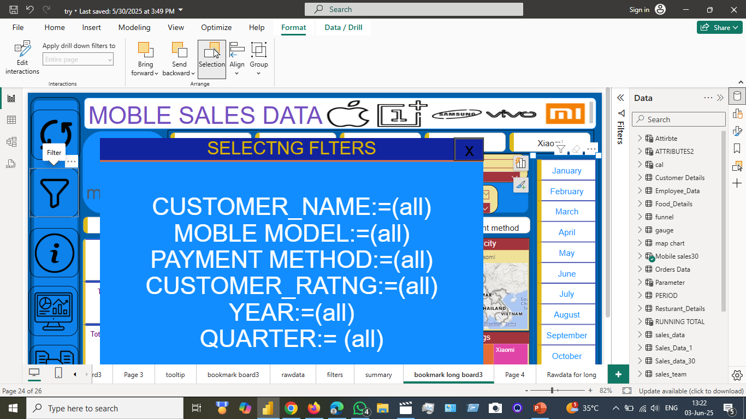
When we click on the particular selection filters that can be create by using the some measure to filter
selected slicer =
var year_=if(ISFILTERED('Mobile sales30'[Year]),CONCATENATEX(ALLSELECTED('Mobile sales30'[Year]),'Mobile sales30'[Year]," ," ),"(all)")
var quarter_=if(ISFILTERED('Mobile sales30'[Quarter]),CONCATENATEX(ALLSELECTED('Mobile sales30'[Quarter]),'Mobile sales30'[Quarter]," ," ),"(all)")
var city_=if(ISFILTERED('Sales_data_30'[City]),CONCATENATEX(ALLSELECTED('Sales_data_30'[City]),'Sales_data_30'[City]," ," ),"(all)")
var customer_=if(ISFILTERED('Sales_data_30'[Customer Name]),CONCATENATEX(ALLSELECTED('Sales_data_30'[Customer Name]),'Sales_data_30'[Customer Name]," ," ),"(all)")
var customer_ratings_=if(ISFILTERED('Sales_data_30'[Customer Ratings]),CONCATENATEX(ALLSELECTED('Sales_data_30'[Customer Ratings]),'Sales_data_30'[Customer Ratings]," ," ),"(all)")
var Payment_=if(ISFILTERED('Sales_data_30'[Payment Method]),CONCATENATEX(ALLSELECTED('Sales_data_30'[Payment Method]),'Sales_data_30'[Payment Method]," ," ),"(all)")
RETURN
"Year := "& year_&UNICHAR(10)&
"Quarter := "& quarter_&UNICHAR(10)&
"City := "& city_&UNICHAR(10)&
"Customer Name := "& customer_&UNICHAR(10)&
"Customer Ratings := "&customer_ratings_&UNICHAR(10)&
"Payment Method := "& Payment_

Slide 20
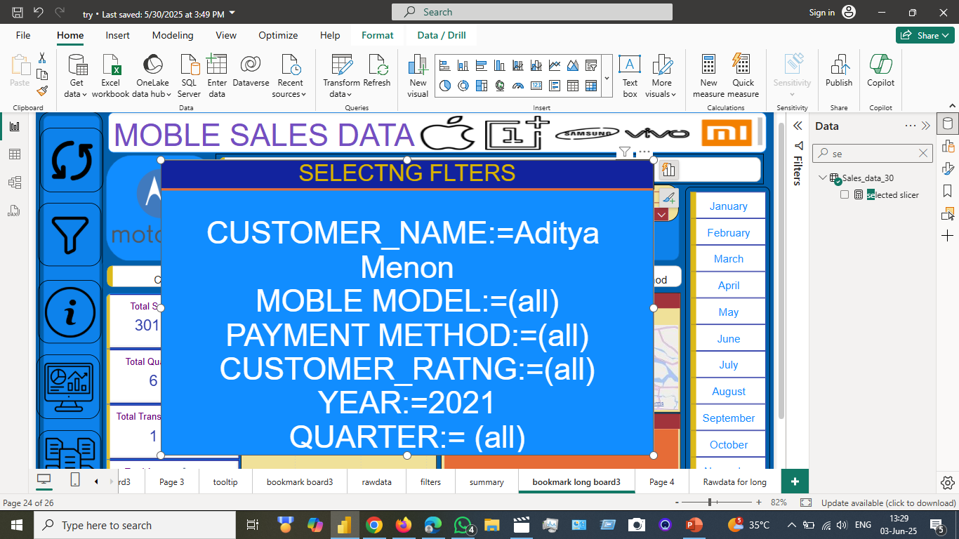
When we click on the particular selection filters that can be created by using some measure to filter when we select the particular name to slicer
selected slicer =
var year_=if(ISFILTERED('Mobile sales30'[Year]),CONCATENATEX(ALLSELECTED('Mobile sales30'[Year]),'Mobile sales30'[Year]," ," ),"(all)")
var quarter_=if(ISFILTERED('Mobile sales30'[Quarter]),CONCATENATEX(ALLSELECTED('Mobile sales30'[Quarter]),'Mobile sales30'[Quarter]," ," ),"(all)")
var city_=if(ISFILTERED('Sales_data_30'[City]),CONCATENATEX(ALLSELECTED('Sales_data_30'[City]),'Sales_data_30'[City]," ," ),"(all)")
var customer_=if(ISFILTERED('Sales_data_30'[Customer Name]),CONCATENATEX(ALLSELECTED('Sales_data_30'[Customer Name]),'Sales_data_30'[Customer Name]," ," ),"(all)")
var customer_ratings_=if(ISFILTERED('Sales_data_30'[Customer Ratings]),CONCATENATEX(ALLSELECTED('Sales_data_30'[Customer Ratings]),'Sales_data_30'[Customer Ratings]," ," ),"(all)")
var Payment_=if(ISFILTERED('Sales_data_30'[Payment Method]),CONCATENATEX(ALLSELECTED('Sales_data_30'[Payment Method]),'Sales_data_30'[Payment Method]," ," ),"(all)")
RETURN
"Year := "& year_&UNICHAR(10)&
"Quarter := "& quarter_&UNICHAR(10)&
"City := "& city_&UNICHAR(10)&
"Customer Name := "& customer_&UNICHAR(10)&
"Customer Ratings := "&customer_ratings_&UNICHAR(10)&
"Payment Method := "& Payment_

Slide 21
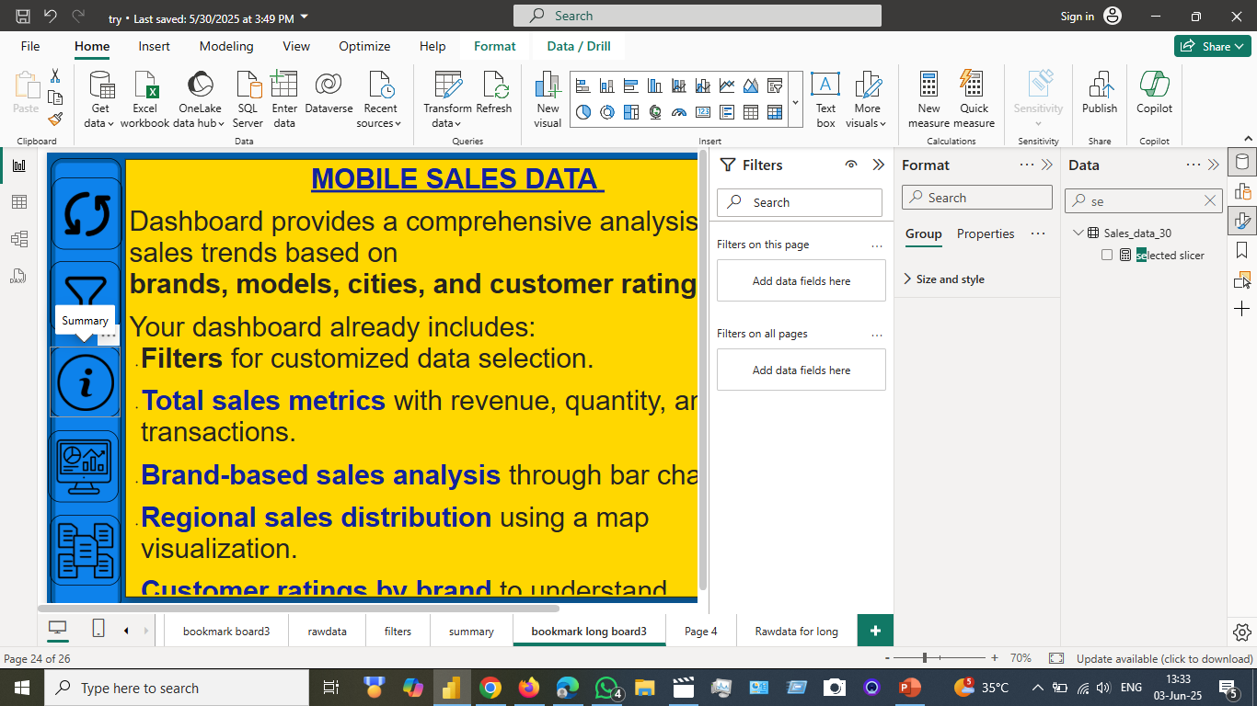
When we assign the data to buttons, we can create bookmarks and assign them to the dashboard by using selection pans We will assign them to bookmarks that assign a summary and give details of the dashboard description

Slide 22
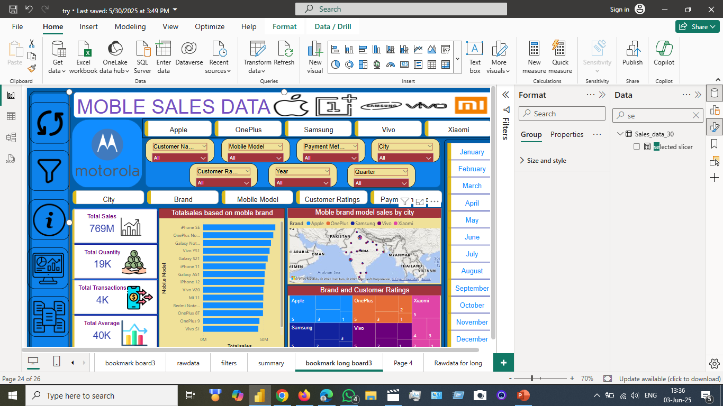
we can create bookmarks and assign them to the dashboard by using selection pans. We will assign them to bookmarks that are assigned and the dashboard that we assign to a particular bookmark

Slide 23
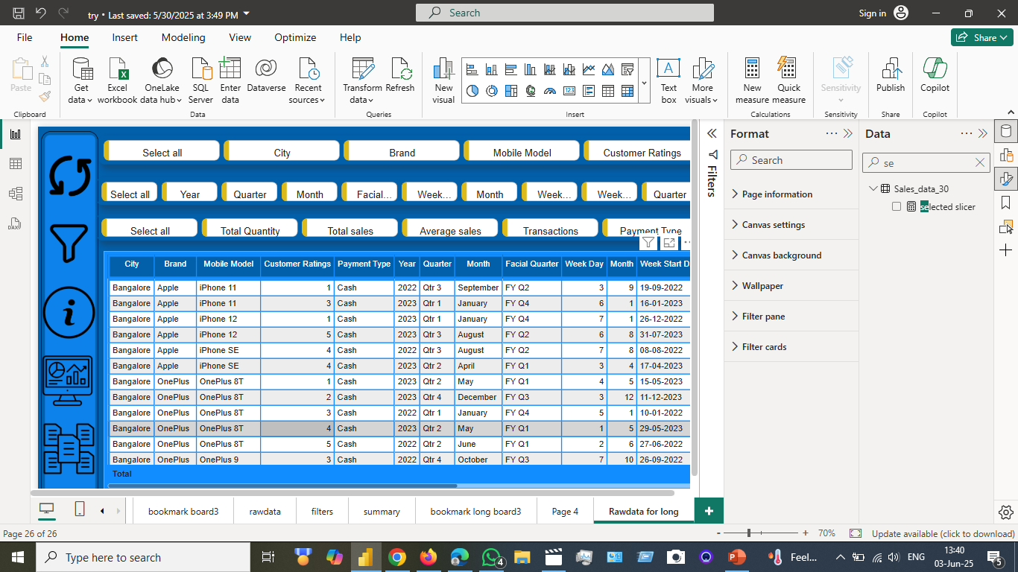
we can create bookmarks and assign them to the dashboard by using selection pans. We will assign them to bookmarks that are assigned and the dashboard to identify the data that the client wants

Slide 24
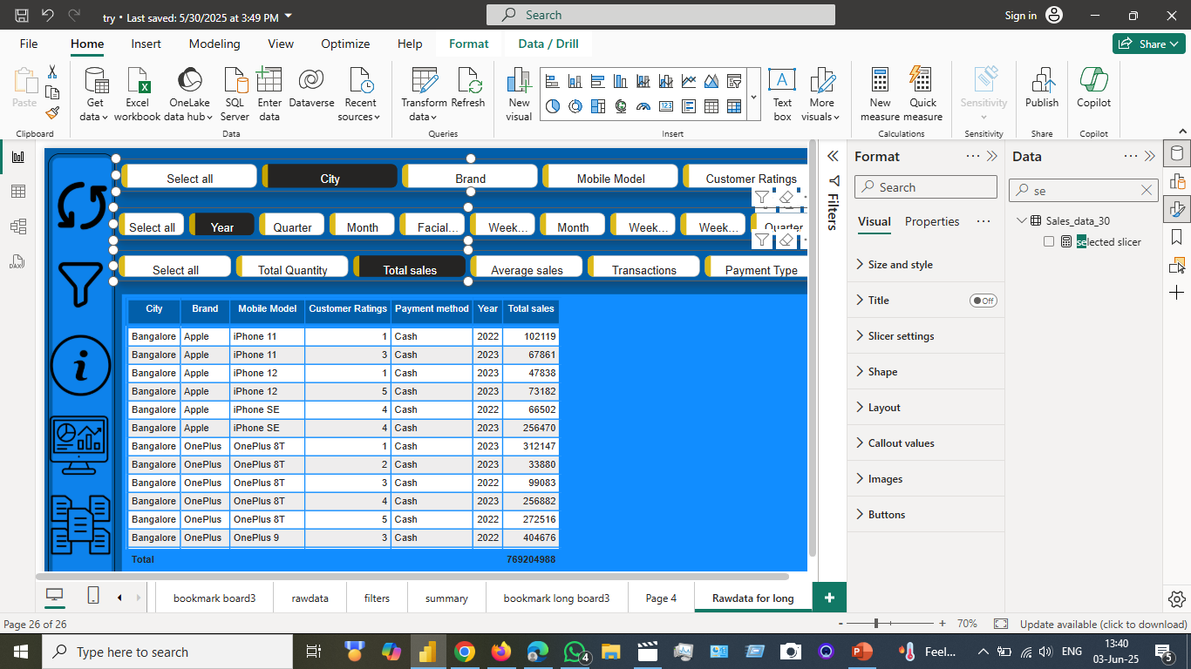

we can create bookmarks and assign them to the dashboard by using selection pans. We will assign the bookmark to assign and want particular data that can change the options that the client wants

